Slide 1
Analysis on Customer Behaviors Presentation
By Joey Tse Kit Yee

Slide 2





Project analysis slide 3
Agenda
Background
Visualizations
Key Insights
Modelling
Suggestions
Have a quick view on dataset
What are the charts
tell us?
Business insights get from the graphs
Better target customers
Business actions to be taken

Slide 3



Background
A presentation on customer behaviors from ecommerce dataset.
Focusing on ‘What kind of customers have higher response to the marketing promotions?’

Slide 4



Factors determined the response rate
Elders respond to the
promotions more
[
How about customers with
different marital status?
Higher education level,
better response rate

Slide 5
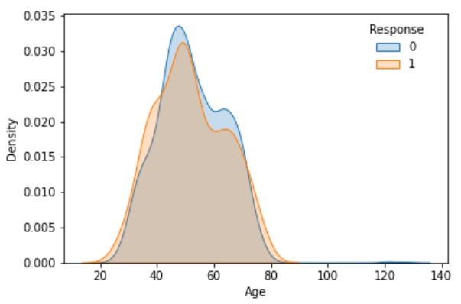
Elders respond to the promotions more
Ages from 20 to 40 and from 70 to 90, those customers tend to respond to the company's promotions.

Slide 6
Business Insights:
The younger customers and older customers may have more spare time.
Customer aged at forty to sixty something, are busy with their works, lives or families, so, less time to react when receiving promotion message.

Slide 7
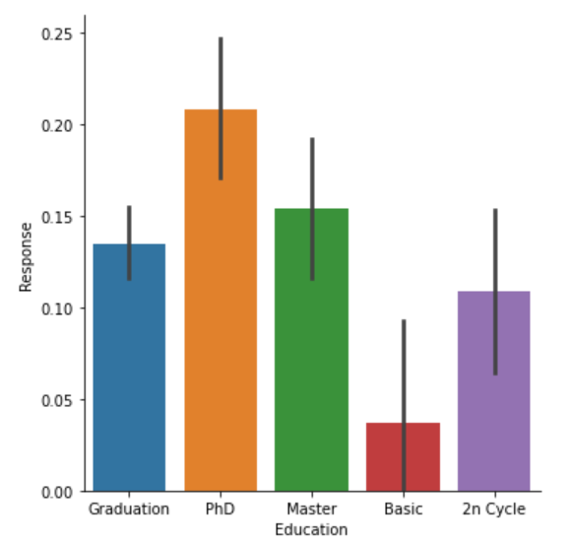
Higher education level Better response rate
Those have PhD-degree is high at 20%, others are around 10%, even lower.

Slide 8

Business Insights:
Customers with higher academic background, they are in touch with more informative message.
We may focus more on people who educated in PhD and Master.

Slide 9
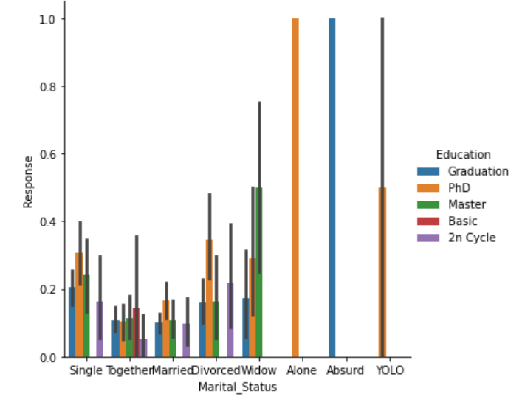
Marital status is critical to response rate
Absolute responses from customer:
Alone PhD
Absurd Undergraduate
Relatively more responses:
Yolo PhD
Widow Master

Slide 10
Business Insights:
Our promotion may focus more on people with widow, alone, absurd and yolo status, they may have more me-time than those together and married status.

Slide 11


Project analysis slide 6
ML Modelling
Machine Learning Algorithms
Traditional Analysis
Good to do one-off computation by algorithm
Emphasis on p-value more with comprehensible model
More prediction-oriented
&
Do predictions at individual level
Mostly interpretation-oriented &
Do analysis at cohort level
ML model helps to detect complex patterns on
determination of higher response rate.

Slide 12
Project analysis slide 2
Process & Advantages of conducting ML models
Extract complicated pattern
between multiple features
Achieve high accuracy of predicting response rate
MODEL
Build a model with 70% of train set and 30% of test set
Compare with y_predict & y_test to
evaluate on the model’s accuracy
Use random forest to carry out the model

Slide 13
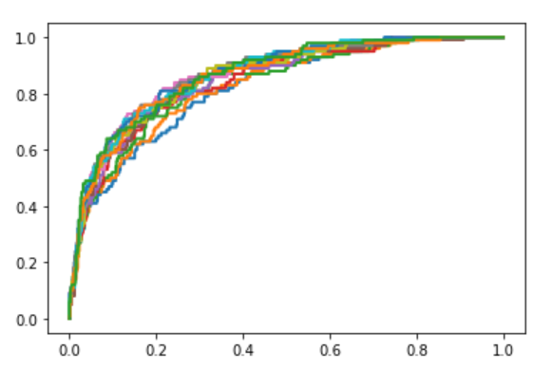
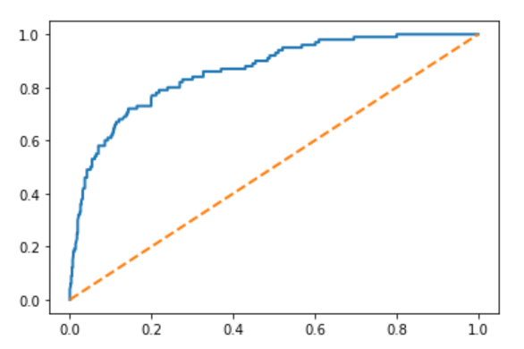
Predicting increasement of response rate
After doing several predictions,
those lines are trending to 1.0,
which are shown the model is getting to be more accurate &
can be well-predicted a more precise rate of promotion response.

Slide 14
Actions can be taken to higher response on promotions
For teens, use an enthusiastic tone
For elderlies, use
a friendly tone
Keep focusing on
teens and elderlies
Tone of Messages
Target
Future Promotion
Develop a new service line on customers aged 40-60
Business Expansion
Content of Messages
Place resources on customers who are widow, alone, absurd and yolo
The usage of words should be more authoritative in order to pander to customers with higher education level
Modify customer service system, even reply system

Slide 15
Actions can be taken to higher response on promotions
Modelling Result
Analysis
Update data with personalized intervention
Regular individual response rate analysis
Improve Marketing Efficiency

Slide 16
Thank You

